Slide 1
A NOVEL APPROACH OF SECURE AUDIO TRANSMISSION IN POST-QUANTUM ERA
Md. Raisul Islam Rifat¹
Md. Mizanur Rahman²
Md. Abdul Kader Nayon¹
Md Shawmoon Azad³
M.R.C. Mahdy³
¹Department of EEE, Chittagong University of Engineering And Technology ²Department of CSE, Rajshahi University of Engineering And Technology ³Department of ECE, North South University, Bashundhara, Dhaka

Slide 2
Index
Introduction to audio encryption
Familiarization with Post Quantum Cryptography
Introduce with QKD, Steganography and ChaCha20-Poly1305
Literature review
Working of E91 protocol
Working of Steganographic Techniques
Working of Chacha20-Poly1305
Audio Encryption property analysis
CHHR Correlation analysis
Tampering Analysis
Conclusion and Future Work
References

Slide 3
Introduction to Encryption
Different Encryption techniques and cryptographic arithmetic associating with audio transmission
1
Most popular – AES and RSA
2
Lots of Computational power required to break RSA
3
But Shor’s Algorithm can break the algorithm in Quantum computing era
4

Slide 4
Post Quantum Cryptography
Quantum proof and Quantum Resistant
Secure against Cryptanalytic attack against Quantum Computer
Use both Classical and Quantum Resistant Algorithm

Slide 5
QKD, SHA & ChaCha
QKD used for exchanging keys- BB84 and E91
SHA, Used for data integrity and digital signature- SHA-1, SHA-2, SHA-3
ChaCha, used for faster and secure encryption system
5

Slide 6
Literature Review
Ref. No. | Paper name | Author | Contribution
1 | Quantum cryptography based on bell’s theorem [1] | A.K Ekert | Proposed E91 Protocol based on Bell’s theorem which can detect the eavesdropping effect.
2 | Cryptographic hash functions: Sha family [2] | B. Madhuravani and D. Murthy | Introducing with the Sha Family
3 | Sha-3 standard: Permutation-based hash and extendable-output functions [3] | M. J. Dworkin | Sha-3, providing better security against attacks
4 | Information hiding using steganography [4] | M. M. Amin, M. Salleh, S. Ibrahim, M. R. Katmin, and M. Shamsuddin | to secure the information completely undetectable by Steganography
5 | Information hiding using audio steganography– a survey [5] | P. Jayaram, H. Ranganatha, and H. Anupama | LSB audio encryption which increases robustness against noise addition and MPEG compression, high capacity and simplicity

Slide 7
Literature Review
Ref. No. | Paper name | Author | Contribution
6 | Novel text steganography approach using quantum key distribution: Survey paper [6] | S. P. Yalla, S. Hemanth, S. T. Kumar, S. Moulali, and S. Dileep | Combining QKD protocol with Steganography increasing the hidden channel capacity
7 | Chacha, a variant of salsa20 [7] | D. J. Bernstein | Introducing with Chacha, which has better software speed compared to salsa20
8 | The poly1305-aes message-authentication code [8] | D. J. Bernstein | Introduce with Poly1305-AES which is a cryptographic tools used to verify the integrity and authenticity of a message

Slide 8
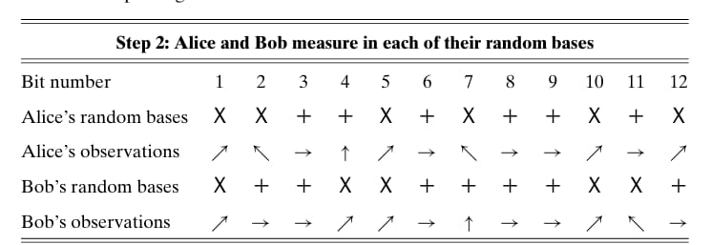
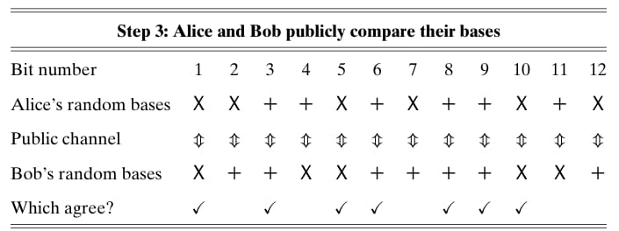
E91 protocol

Slide 9
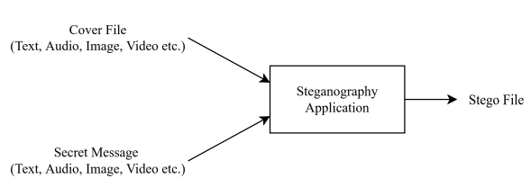
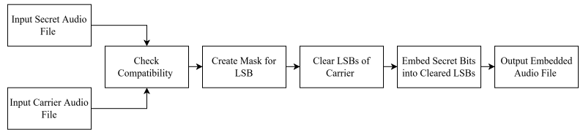
Steganography
There are different methods of steganography.
Among them some notables are: LSB Coding, Parity Coding, Phase coding, Spread spectrum, Echo hiding etc
A very popular methodology among them is the LSB(Least Significant Bit) algorithm, which only replaces the least significant bits of the some of the bytes of the cover audio.
Table: Steganography Techniques
Table: LSB Steganography Techniques

Slide 10
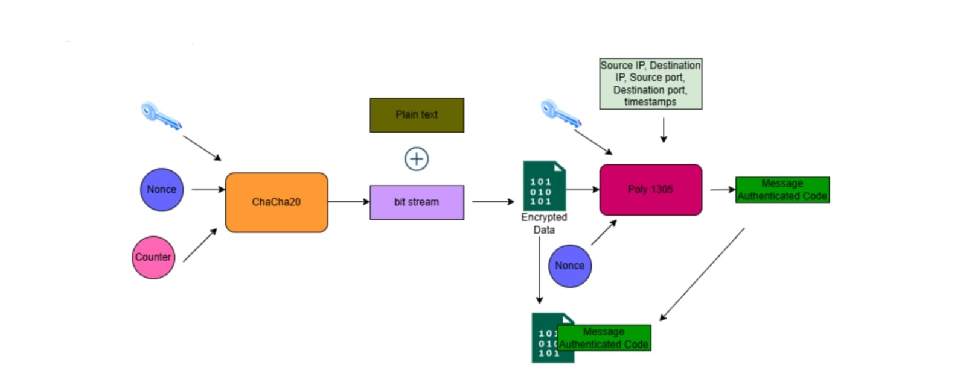
ChaCha20-Poly1305
ChaCha20-Poly1305 is an authenticated encryption with associated data (AEAD) algorithm
Faster than AES-GCM (Galois/Counter Mode) in the absence of hardware acceleration
This algorithm combines the ChaCha20 stream cipher and the Poly1305 universal hash family that acts as message authentication code
Figure: Chacha20-Poly1305 working process

Slide 11
Problem Statement
Problem Statement
Limitations of previous works:
Aim is to fulfill the following criteria:
Absence of ChaCha Poly1305 alongside SHA and QKD
Combining ChaCha Poly1305 with SHA and QKD
1
Low security in audio encryption
Provide more secure audio encryption
2
11

Slide 12
Thesis Objectives
1
To propose an original architecture that successfully combines E91 QKD protocol, ChaCha20-Poly1305 AEAD and audio steganography using LSB.
2
To utilize E91 as the key distribution protocol which employs principles of quantum mechanics for secure key exchange.
3
To Assimilate audio steganography using LSB substitution into the architecture to augment the security and robustness of the overall system.
4
To improve the gain of the proposed CP antenna.
5
To assess the performance and reliability of the proposed scheme by measuring the security through end-to-end encryption
4
6
To minimize the overall size of the proposed CP antenna.

Slide 13
Tools
1. Software Tools:
Qiskit (IBM): Python-based framework for IBM quantum computers.
2. Quantum Simulator:
a. IBM’s Aer: Allow testing and debugging quantum algorithms on classical computers.
3. Language Support:
a. Python
4. Visualization Tools:
a. Matplotlib: Used in conjunction with Python frameworks to visualize quantum states and cryptographic results.
b. Qiskit Visualization Tool: For plotting quantum circuits, histograms, and entanglement diagrams.

Slide 14
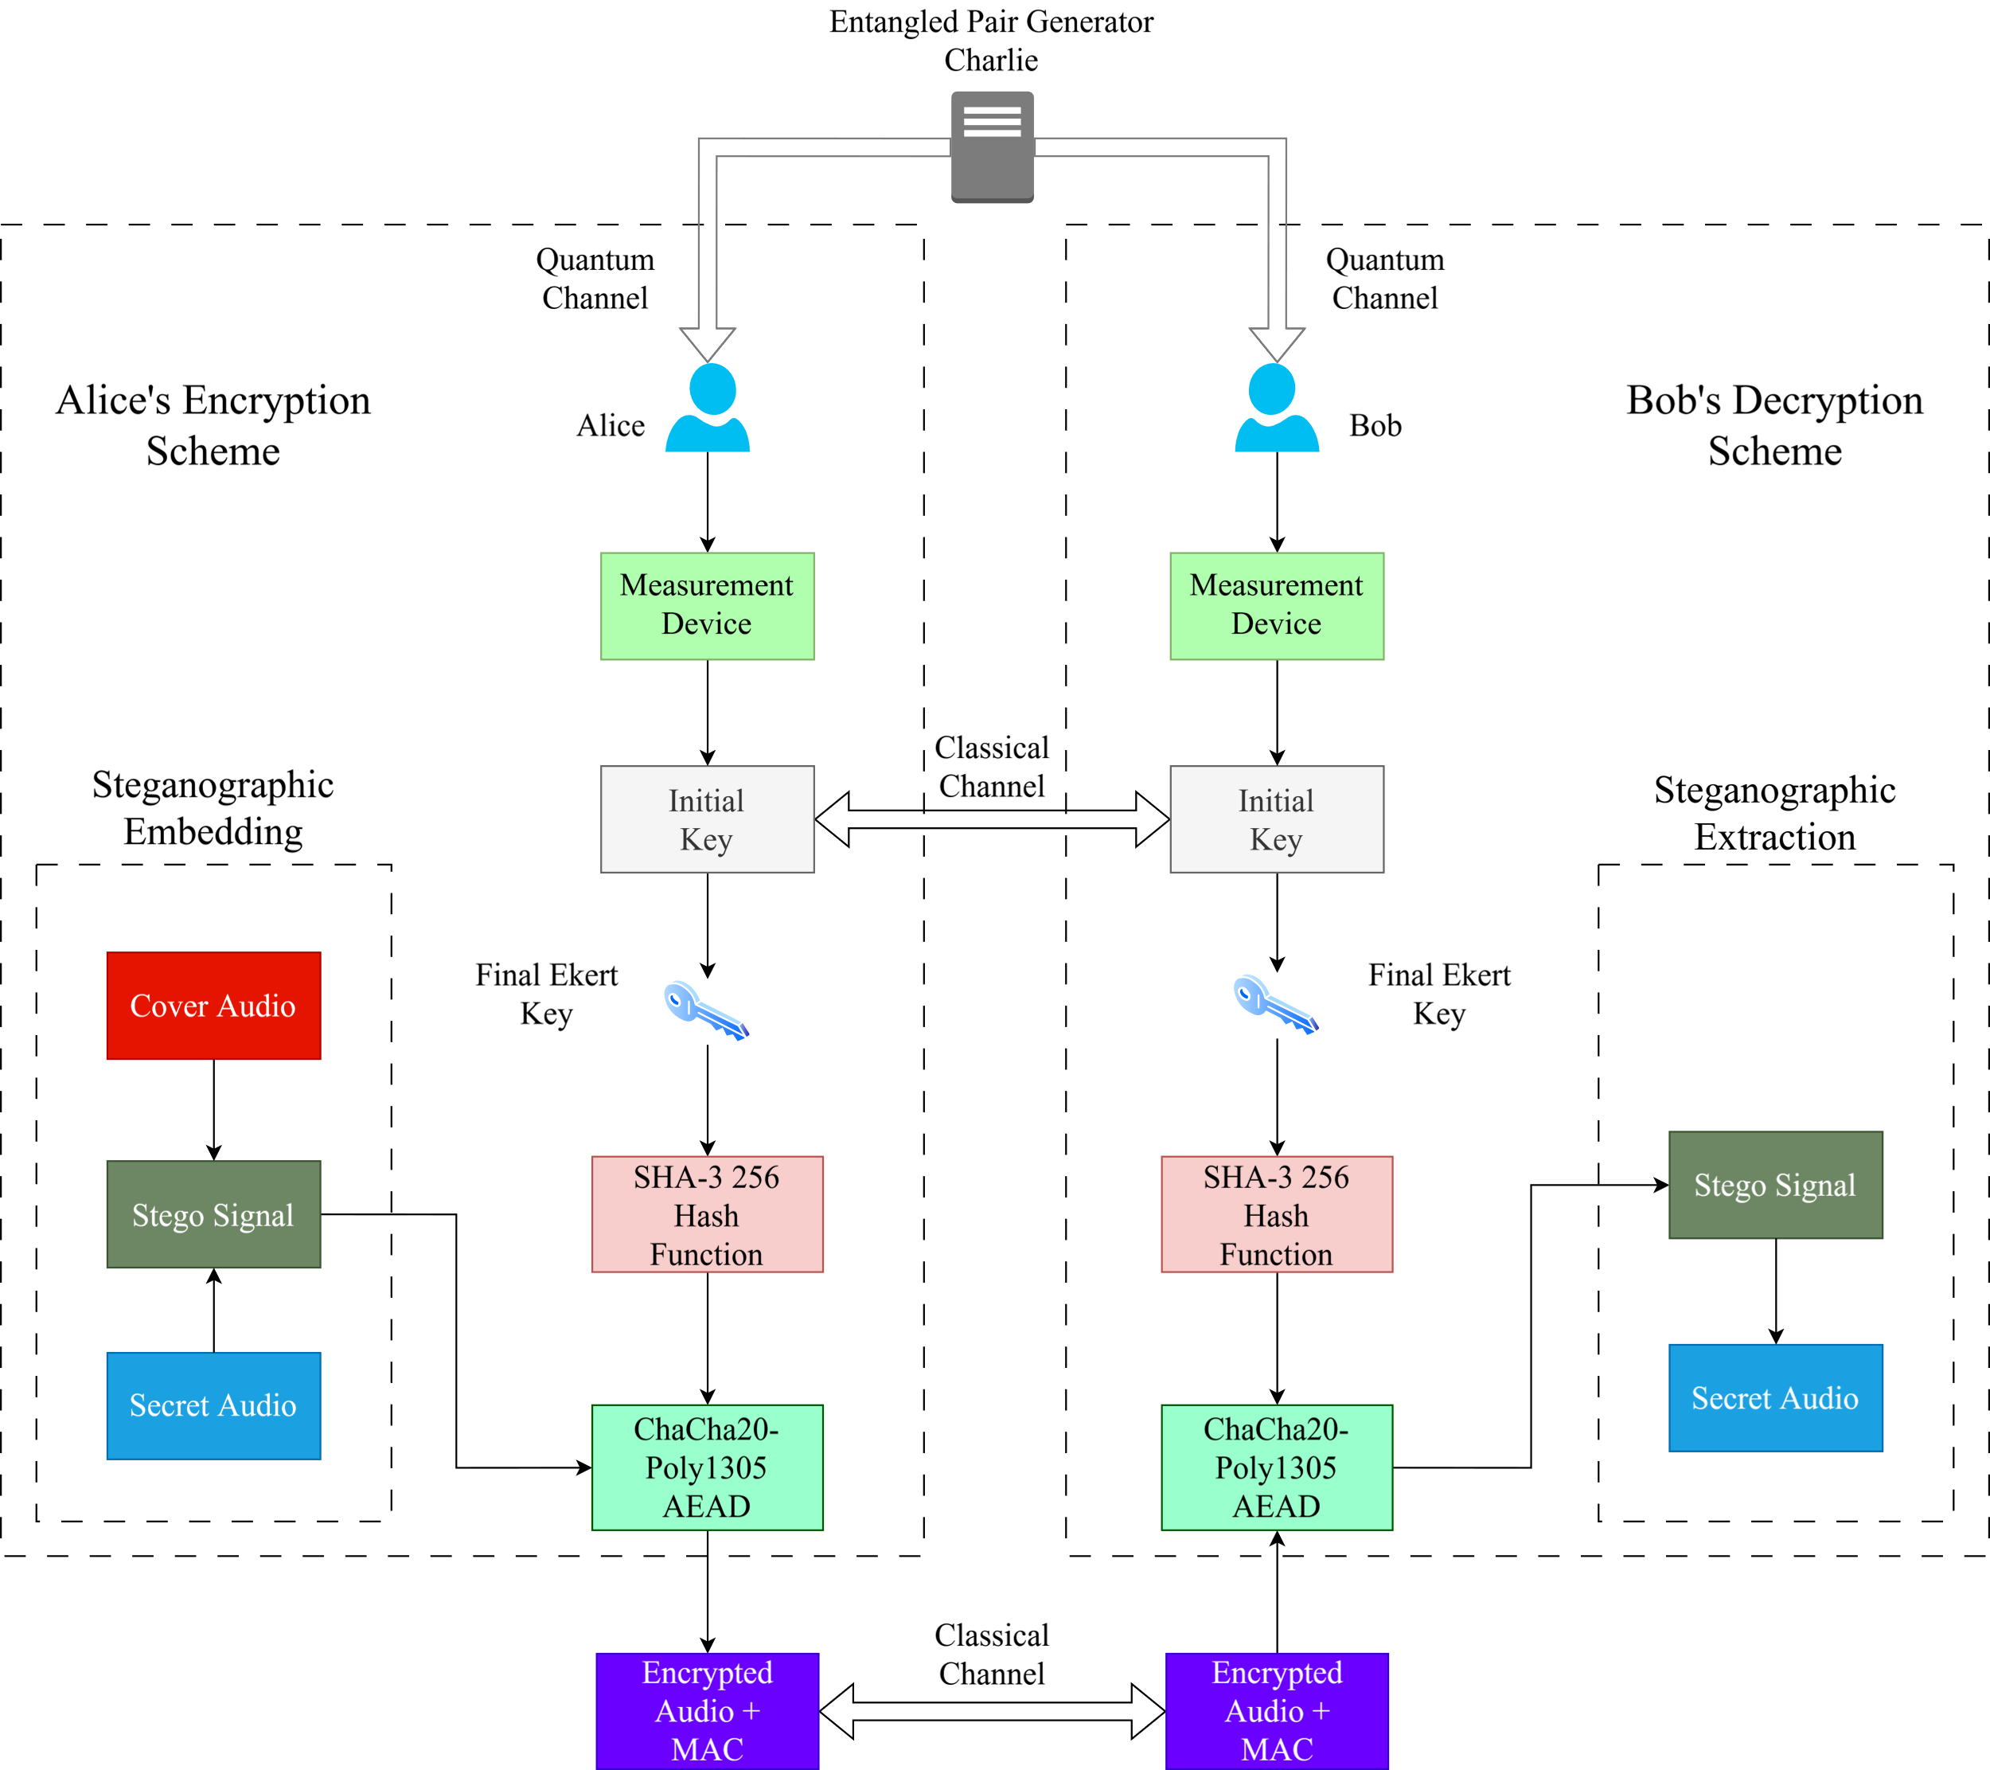
Methodology

Slide 15
Encrypted Audio Properties
Analysis Metrices | Audio 1(encrypted1.wav) | Audio2(encrypted2.wav)
Entropy | 7.999996690800791 | 7.999997028544158
Correlation with original embedded audio | -4.515503267166404 × 10⁻⁵ | -5.8256422990290715 × 10⁻⁵
UACI | 49.99981961917535 | 50.00009364535334
NSCR | 99.61122960461951% | 99.61018917381404%
Table: Summary of analysis of the encrypted audio properties

Slide 16
CHSH Correlation
Iteration | Key length | No. of Mismatched Bits | CHSH
1 | 109 | 0 | 2.794
2 | 131 | 0 | 2.754
3 | 215 | 0 | 2.636
4 | 44 | 0 | 3.009
Iteration | Key length | No. of Mismatched Bits | CHSH | Eve’s Knowledge of Alice’s Key | Eve’s Knowledge of Bob’s Key
1 | 126 | 16 | 1.229 | 81.1% | 96.03%
2 | 142 | 12 | 1.346 | 93.66% | 93.66%
3 | 243 | 32 | 1.37 | 93.83% | 90.53%
4 | 44 | 7 | 1.48 | 95.45% | 84.09%
Table: CHSH correlation values for different key lengths in the absence of an eavesdropper
Table: CHSH correlation values for different key lengths in the presence of an eavesdropper

Slide 17
Tampering Analysis
 | encrypted1.bin | encrypted2.bin
Sender end | Nonce: 5e4ef364b086ab3e2d1118cb Tag: 416c6c92659047d2f0660c36f58c1fa5 | Nonce: d64f6fe0710ebeb0324e8cc6 Tag: 5977c55fe95a60173ff7476bfad4c29a
Receiver end | Nonce: 5e4ef364b086ab3e2d1118cb Tag: 416c6c92659047d2f0660c36f58c1fa5 | Nonce: d64f6fe0710ebeb0324e8cc6 Tag: 5977c55fe95a60173ff7476bfad4c29a
Operation status | Verification successful! Decryption successful! | Verification successful! Decryption successful!
Table: Without Tampering
 | encrypted1.bin | encrypted2.bin
Sender end | Nonce: 5e4ef364b086ab3e2d1118cb Tag: 416c6c92659047d2f0660c36f58c1fa5 | Nonce: d64f6fe0710ebeb0324e8cc6 Tag: 5977c55fe95a60173ff7476bfad4c29a
Receiver end | Nonce: ---------------------------- Tag: ------------------------------ | Nonce: ---------------------------- Tag: ------------------------------
Operation status | Verification failed! Decryption failed! | Verification failed! Decryption failed!
Table: With Tampering

Slide 18
Conclusions
Attempted to secure digital audio transmission combining the Quantum Key Distribution (QKD) specifically E91 with classical encryption system, secure hash function and audio steganography using LSB and also ChaCha20-Poly1305.
Proposed model is sustainable against different types of attacks.
Quantum key distribution can be changed for better output.
Steganography technique can be improved.
Text, images can also be excluded by filtering our algorithm.

Slide 19
References
[1] A. K. Ekert, “Quantum cryptography based on bell’s theorem,” Physical review letters, vol. 67,
no. 6, p. 661, 1991.
[2] B. Madhuravani and D. Murthy, “Cryptographic hash functions: Sha family,” Int J Innov Technol Explor Eng, vol. 2, pp. 326–9, 2013.
[3] M. J. Dworkin, “Sha-3 standard: Permutation-based hash and extendable-output functions,” 2015
[4] M. M. Amin, M. Salleh, S. Ibrahim, M. R. Katmin, and M. Shamsuddin, “Information hiding using steganography,” in 4th National Conference of Telecommunication Technology, 2003. NCTT 2003 Proceedings., pp. 21–25, IEEE, 2003
[5] P. Jayaram, H. Ranganatha, and H. Anupama, “Information hiding using audio steganography– a survey,” The International Journal of Multimedia & Its Applications (IJMA) Vol, vol. 3, pp. 86–96, 2011
[6] S. P. Yalla, S. Hemanth, S. T. Kumar, S. Moulali, and S. Dileep, “Novel text steganography approach using quantum key distribution: Survey paper,” NeuroQuantology, vol. 20, no. 13, p. 923, 2022
[7] D. J. Bernstein et al., “Chacha, a variant of salsa20,” in Workshop record of SASC, vol. 8, pp. 3–5, Citeseer, 2008
[8] D. J. Bernstein, “The poly1305-aes message-authentication code,” in International workshop
on fast software encryption, pp. 32–49, Springer, 2005

Slide 20
THANK YOU

